Slide 1
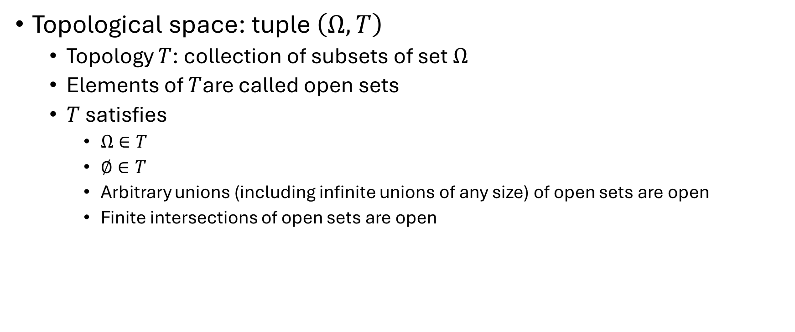
Topological spaces
Topological space: tuple $\left(Ω,T\right)$
Topology $T$: collection of subsets of set $Ω$
Elements of $T$are called open sets
$T$ satisfies
$Ω∈T$
$∅∈T$
Arbitrary unions (including infinite unions of any size) of open sets are open
Finite intersections of open sets are open

Slide 2
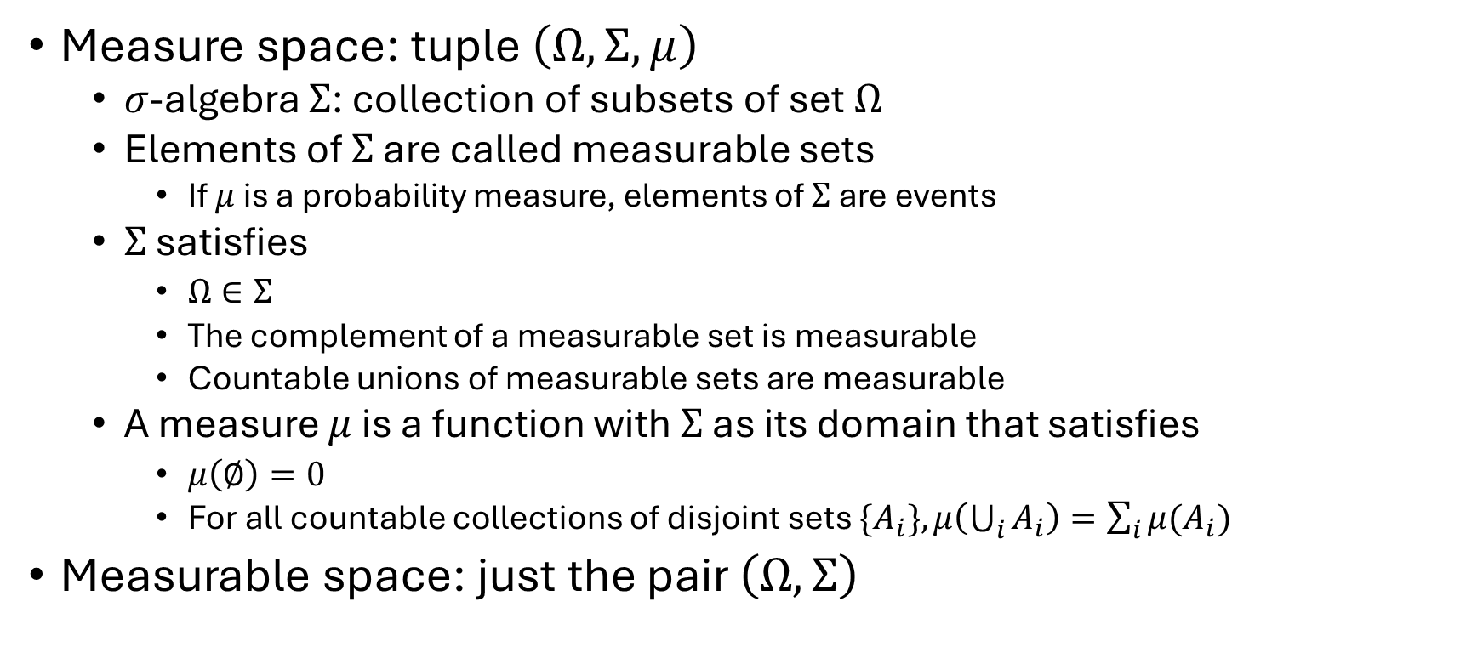
Measure spaces
Measure space: tuple $\left(Ω,Σ,μ\right)$
$σ$-algebra $Σ$: collection of subsets of set $Ω$
Elements of $Σ$ are called measurable sets
If $μ$ is a probability measure, elements of $Σ$ are events
$Σ$ satisfies
$Ω∈Σ$
The complement of a measurable set is measurable
Countable unions of measurable sets are measurable
A measure $μ$ is a function with $Σ$ as its domain that satisfies
$μ\left(∅\right)=0$
For all countable collections of disjoint sets $\{A_{i}\},μ\left(\bigcup_{i}{A_{i}}\right)=\sum_{i}{μ(A_{i})}$
Measurable space: just the pair $\left(Ω,Σ\right)$

Slide 3
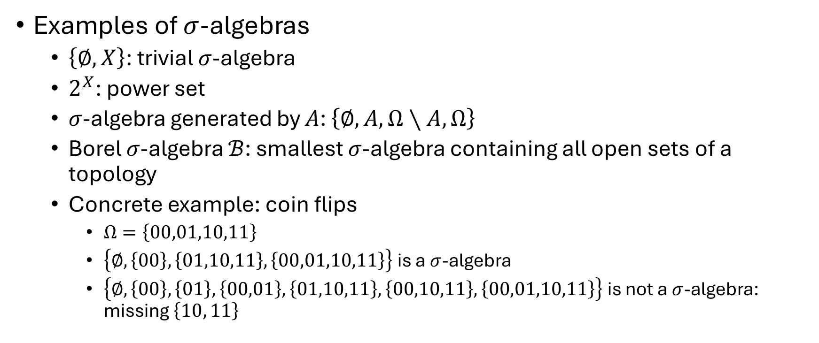
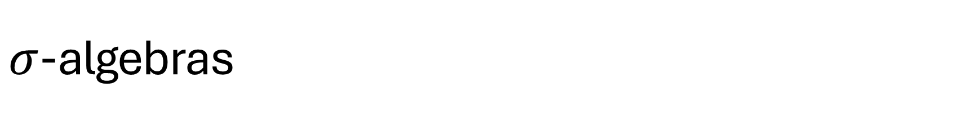
$σ$-algebras
Examples of $σ$-algebras
$\left\{∅,X\right\}$: trivial $σ$-algebra
$2^{X}$: power set
$σ$-algebra generated by $A$: $\left\{∅,A,Ω∖A,Ω\right\}$
Borel $σ$-algebra $ℬ$: smallest $σ$-algebra containing all open sets of a topology
Concrete example: coin flips
$Ω=\left\{00,01,10,11\right\}$
$\left\{∅,\left\{00\right\},\left\{01,10,11\right\},\left\{00,01,10,11\right\}\right\}$ is a $σ$-algebra
$\left\{∅,\left\{00\right\},\left\{01\right\},\left\{00,01\right\},\left\{01,10,11\right\}, \left\{00,10,11\right\},\left\{00,01,10,11\right\}\right\}$ is not a $σ$-algebra: missing $\left\{10, 11\right\}$

Slide 4
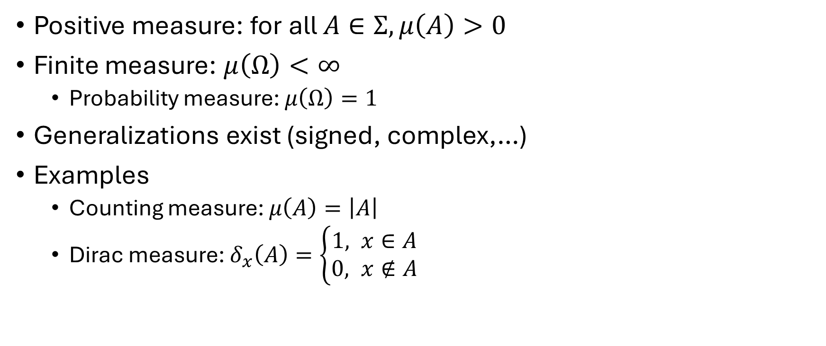
Measures
Positive measure: for all $A∈Σ,μ\left(A\right)>0$
Finite measure: $μ\left(Ω\right)<∞$
Probability measure: $μ\left(Ω\right)=1$
Generalizations exist (signed, complex,…)
Examples
Counting measure: $μ\left(A\right)=\left|A\right|$
Dirac measure: $δ_{x}\left(A\right)=\left\{\begin{aligned}1, x∈A \\ 0, x∉A\end{aligned}\right.$

Slide 5
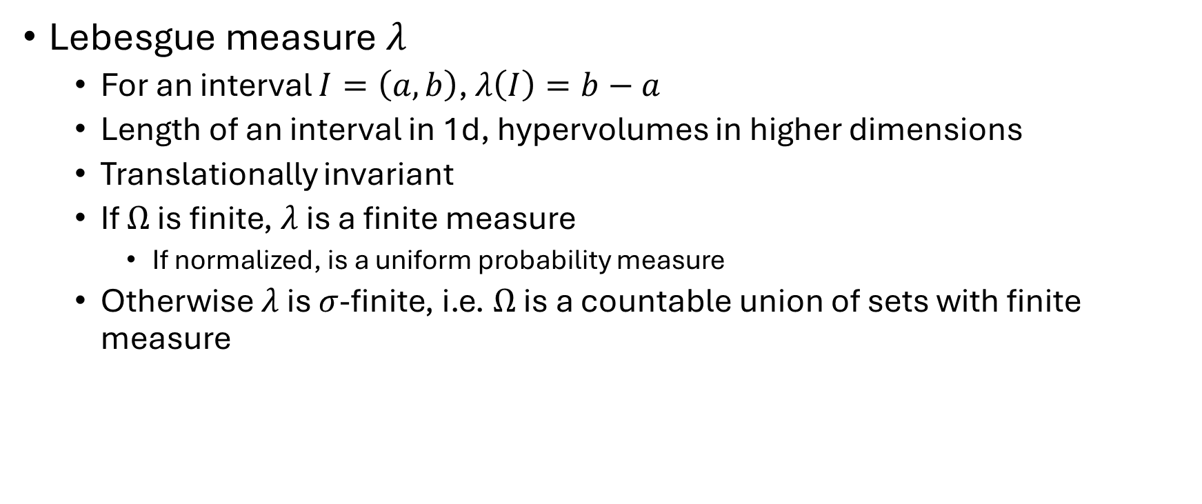
Measures
Lebesgue measure $λ$
For an interval $I=\left(a,b\right)$, $λ\left(I\right)=b−a$
Length of an interval in 1d, hypervolumes in higher dimensions
Translationally invariant
If $Ω$ is finite, $λ$ is a finite measure
If normalized, is a uniform probability measure
Otherwise $λ$ is $σ$-finite, i.e. $Ω$ is a countable union of sets with finite measure

Slide 6

Measurable functions
Function $f:Ω_{1}→Ω_{2}$
Measurable spaces $\left(Ω_{1},Σ_{1}\right)$ and $\left(Ω_{2},Σ_{2}\right)$
$f$ is measurable with respect to $\left(Ω_{1},Σ_{1}\right)$ if $∀B∈Σ_{2}, f^{−1}\left(B\right)∈Σ_{1}$
Random variables are measurable functions

Slide 7
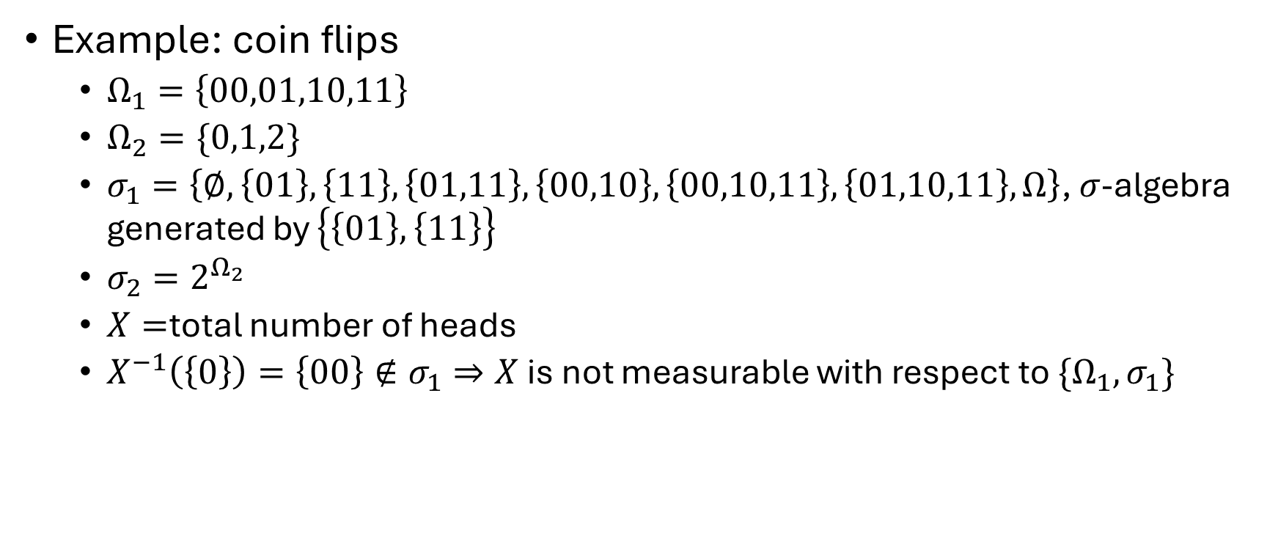
Measurable functions
Example: coin flips
$Ω_{1}=\left\{00,01,10,11\right\}$
$Ω_{2}=\{0,1,2\}$
$σ_{1}=\left\{∅,\left\{01\right\},\left\{11\right\},\left\{01,11\right\},\left\{00,10\right\},\left\{00,10,11\right\},\left\{01,10,11\right\},Ω\right\}$, $σ$-algebra generated by $\left\{\left\{01\right\},\left\{11\right\}\right\}$
$σ_{2}=2^{Ω_{2}}$
$X=$total number of heads
$X^{−1}\left(\left\{0\right\}\right)=\left\{00\right\}∉σ_{1}⇒X$ is not measurable with respect to $\{Ω_{1},σ_{1}\}$

Slide 8
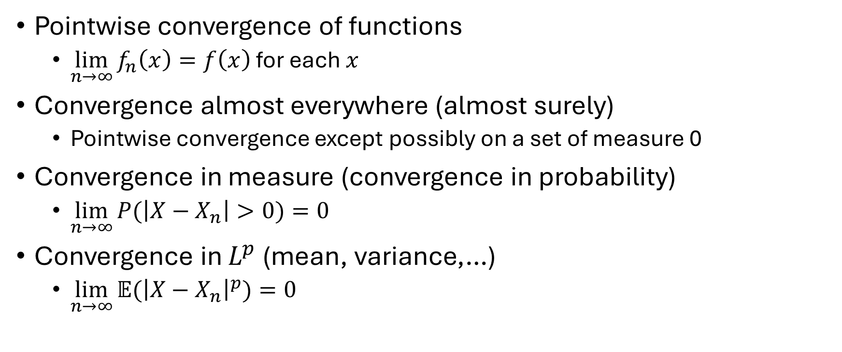
Convergence of random variables
Pointwise convergence of functions
$\lim_{n→∞}{f_{n}\left(x\right)=f\left(x\right)}$ for each $x$
Convergence almost everywhere (almost surely)
Pointwise convergence except possibly on a set of measure 0
Convergence in measure (convergence in probability)
$\lim_{n→∞}{P(\left|X−X_{n}\right|>0)}=0$
Convergence in $L^{p}$ (mean, variance,…)
$\lim_{n→∞}{𝔼({\left|X−X_{n}\right|}^{p})}=0$

Slide 9
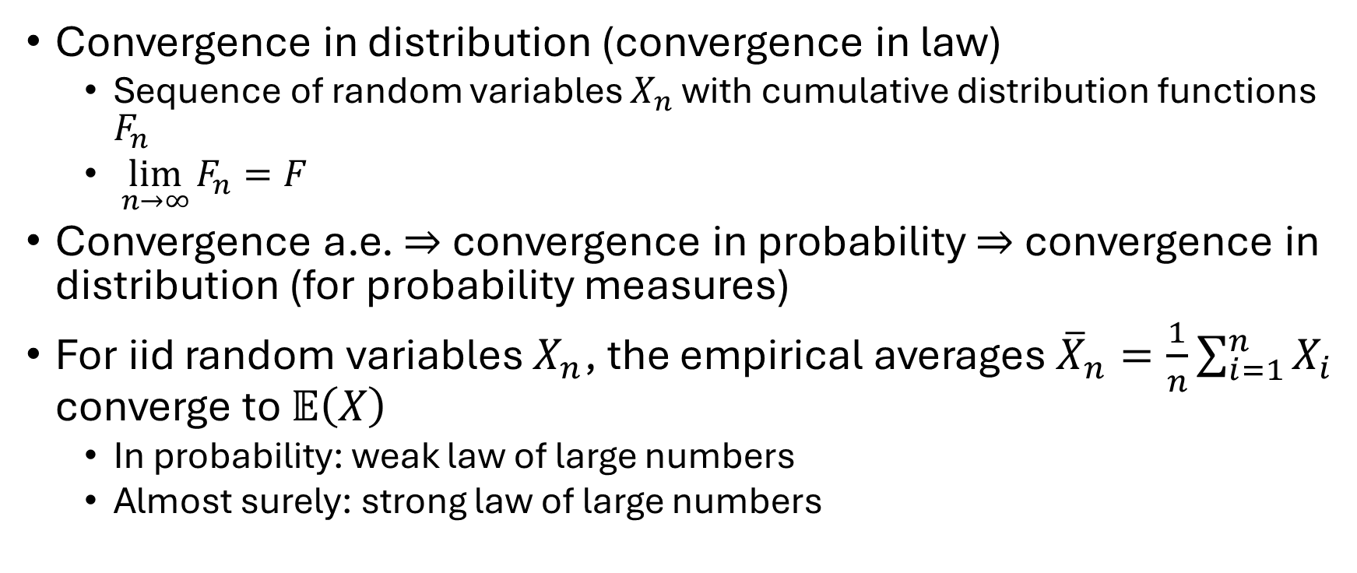
Convergence of random variables
Convergence in distribution (convergence in law)
Sequence of random variables $X_{n}$ with cumulative distribution functions $F_{n}$
$\lim_{n→∞}{F_{n}}=F$
Convergence a.e. $⇒$ convergence in probability $⇒$ convergence in distribution (for probability measures)
For iid random variables $X_{n}$, the empirical averages ${\overline{X}}_{n}=\frac{1}{n}\sum_{i=1}^{n}{X_{i}}$ converge to $𝔼\left(X\right)$
In probability: weak law of large numbers
Almost surely: strong law of large numbers

Slide 10
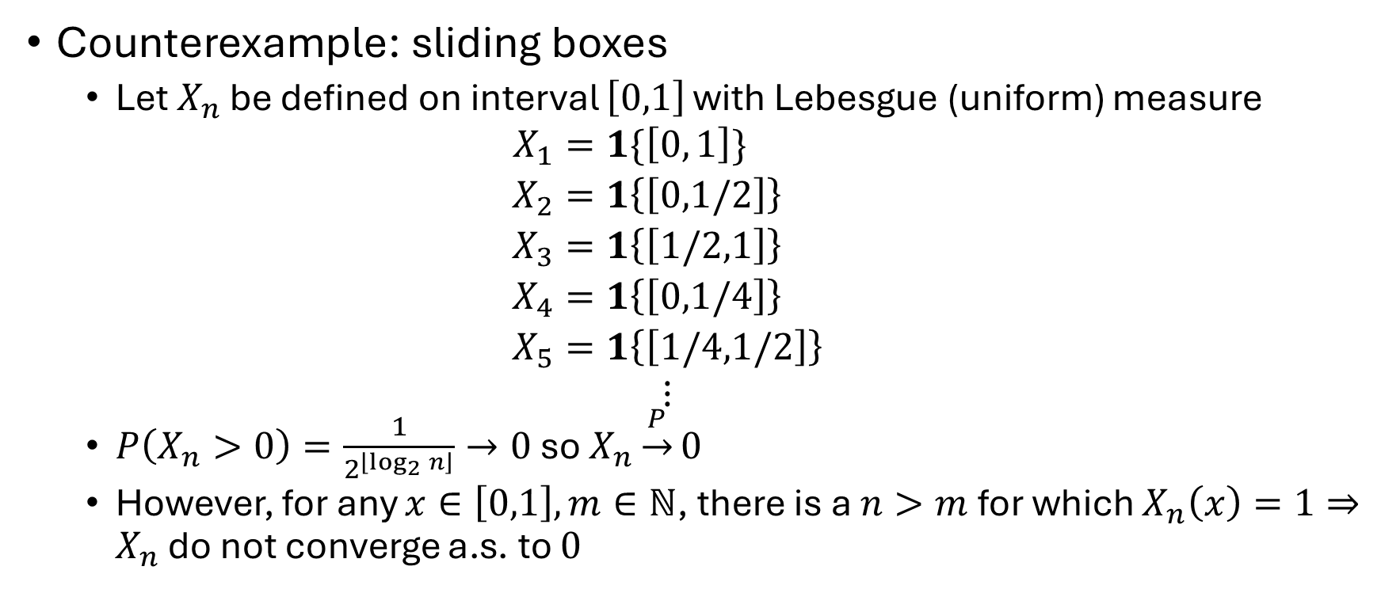
Convergence of random variables
Counterexample: sliding boxes
Let $X_{n}$ be defined on interval $\left[0,1\right]$ with Lebesgue (uniform) measure
$$\begin{aligned}X_{1}&=1\{\left[0, 1\right]\} \\ X_{2}&=1\left\{\left[0,1/2\right]\right\} \\ X_{3}&=1\left\{\left[1/2,1\right]\right\} \\ X_{4}&=1\left\{\left[0,1/4\right]\right\} \\ X_{5}&=1\left\{\left[1/4,1/2\right]\right\} \\ ⋮\end{aligned}$$
$P\left(X_{n}>0\right)=\frac{1}{2^{\left\lfloor \log_{2}{n}\right\rfloor }}→0$ so $X_{n}\underset{→}{P}0$
However, for any $x∈\left[0,1\right],m∈ℕ$, there is a $n>m$ for which $X_{n}\left(x\right)=1⇒X_{n}$ do not converge a.s. to $0$

Slide 11
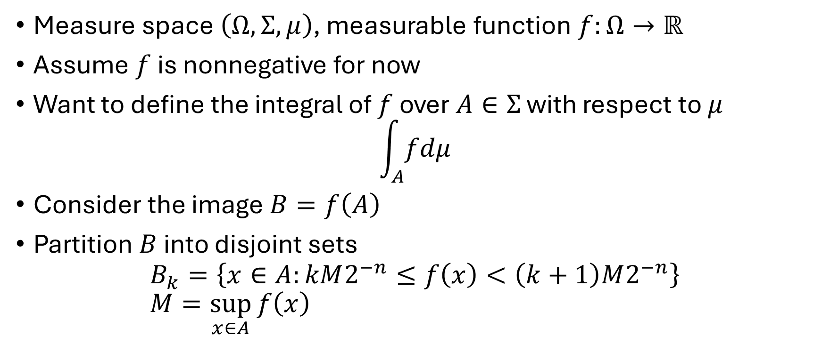
Integration
Measure space $\left(Ω,Σ,μ\right)$, measurable function $f:Ω→ℝ$
Assume $f$ is nonnegative for now
Want to define the integral of $f$ over $A∈Σ$ with respect to $μ$
$$\int_{A}{fdμ}$$
Consider the image $B=f\left(A\right)$
Partition $B$ into disjoint sets
$$B_{k}=\left\{x∈A:kM2^{−n}≤f\left(x\right)<\left(k+1\right)M2^{−n}\right\} \\ M=\sup_{x∈A}{f\left(x\right)}$$

Slide 12
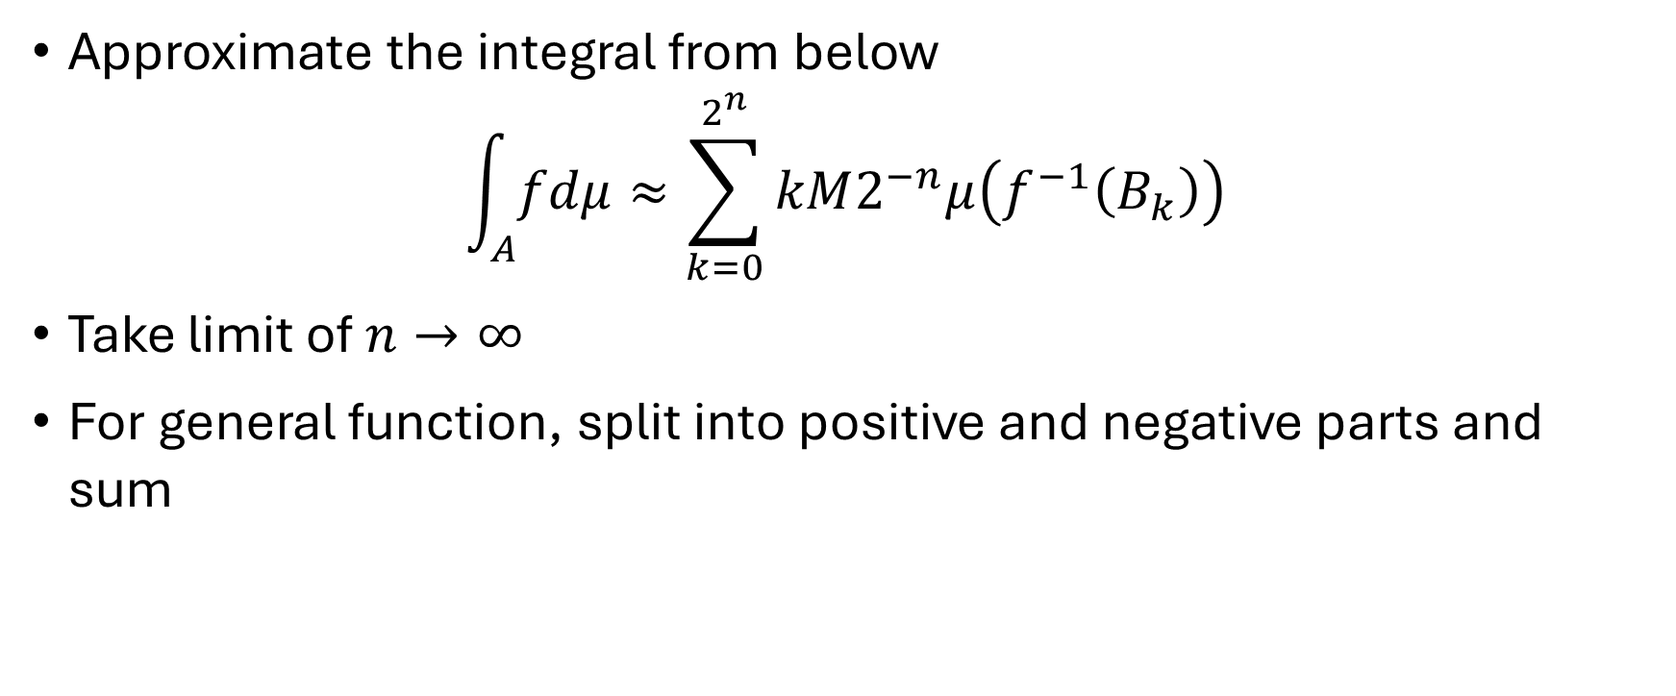
Integration
Approximate the integral from below
$$\int_{A}{fdμ}≈\sum_{k=0}^{2^{n}}{kM2^{−n}μ\left(f^{−1}\left(B_{k}\right)\right)}$$
Take limit of $n→∞$
For general function, split into positive and negative parts and sum

Slide 13
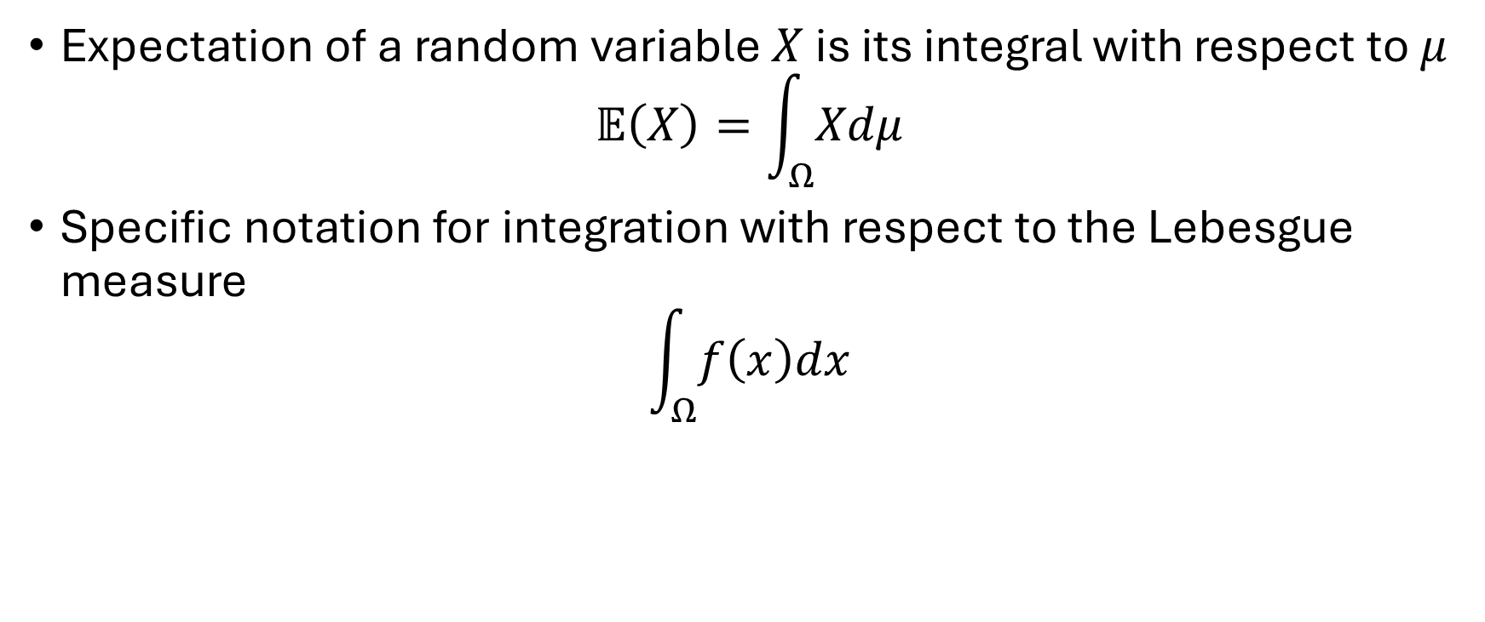
Integration
Expectation of a random variable $X$ is its integral with respect to $μ$
$$𝔼\left(X\right)=\int_{Ω}{Xdμ}$$
Specific notation for integration with respect to the Lebesgue measure
$$\int_{Ω}{f\left(x\right)dx}$$

Slide 14
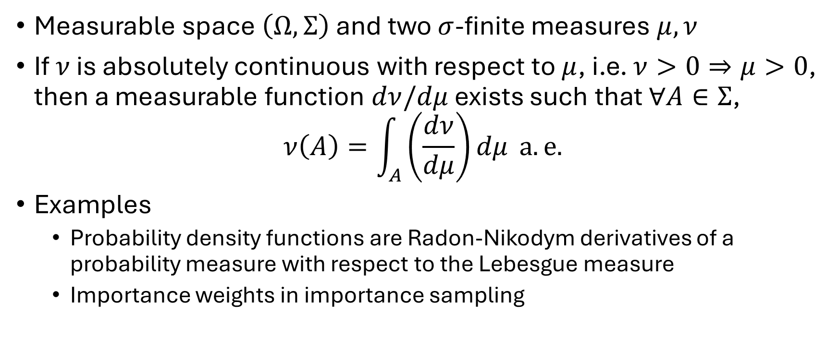
Radon-Nikodym derivatives
Measurable space $\left(Ω,Σ\right)$ and two $σ$-finite measures $μ,ν$
If $ν$ is absolutely continuous with respect to $μ$, i.e. $ν>0⇒μ>0$, then a measurable function $dν/dμ$ exists such that $∀A∈Σ$,
$$ν\left(A\right)=\int_{A}{\left(\frac{dν}{dμ}\right)dμ} a.e.$$
Examples
Probability density functions are Radon-Nikodym derivatives of a probability measure with respect to the Lebesgue measure
Importance weights in importance sampling

Slide 15
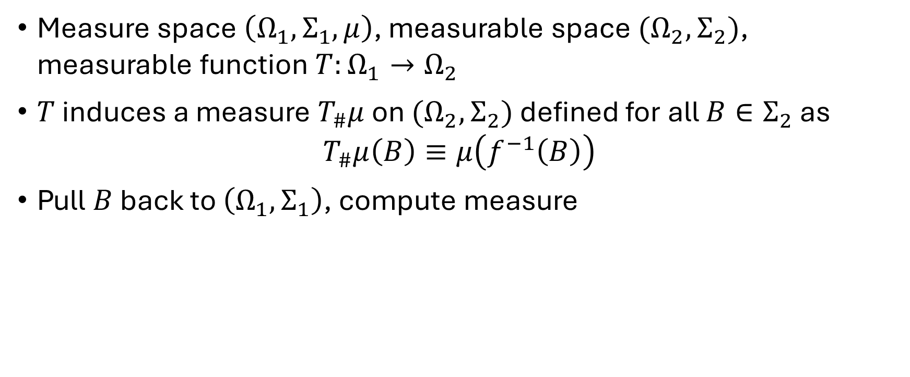
Pushforward measures
Measure space $\left(Ω_{1},Σ_{1},μ\right)$, measurable space $(Ω_{2},Σ_{2})$, measurable function $T:Ω_{1}→Ω_{2}$
$T$ induces a measure $T_{\#}μ$ on $(Ω_{2},Σ_{2})$ defined for all $B∈Σ_{2}$ as
$$T_{\#}μ\left(B\right)≡μ\left(f^{−1}\left(B\right)\right)$$
Pull $B$ back to $\left(Ω_{1},Σ_{1}\right)$, compute measure

Slide 16
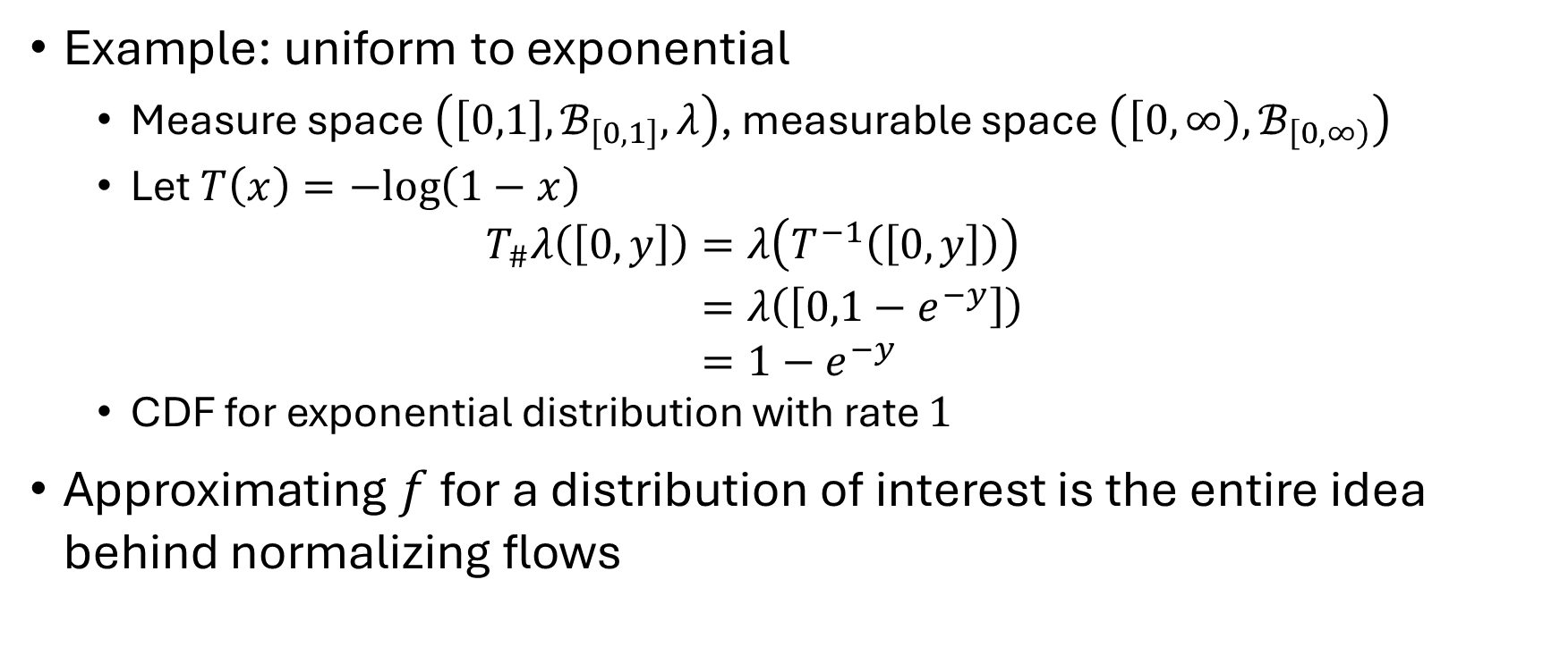
Pushforward measures
Example: uniform to exponential
Measure space $\left(\left[0,1\right],ℬ_{\left[0,1\right]},λ\right)$, measurable space $\left(\left[0,∞\right),ℬ_{\left[0,∞\right)}\right)$
Let $T\left(x\right)=−log\left(1−x\right)$ $\begin{aligned}T_{\#}λ\left(\left[0,y\right]\right)&=λ\left(T^{−1}\left(\left[0,y\right]\right)\right) \\ &=λ\left(\left[0,1−e^{−y}\right]\right) \\ &=1−e^{−y}\end{aligned}$
CDF for exponential distribution with rate $1$
Approximating $f$ for a distribution of interest is the entire idea behind normalizing flows

Slide 17
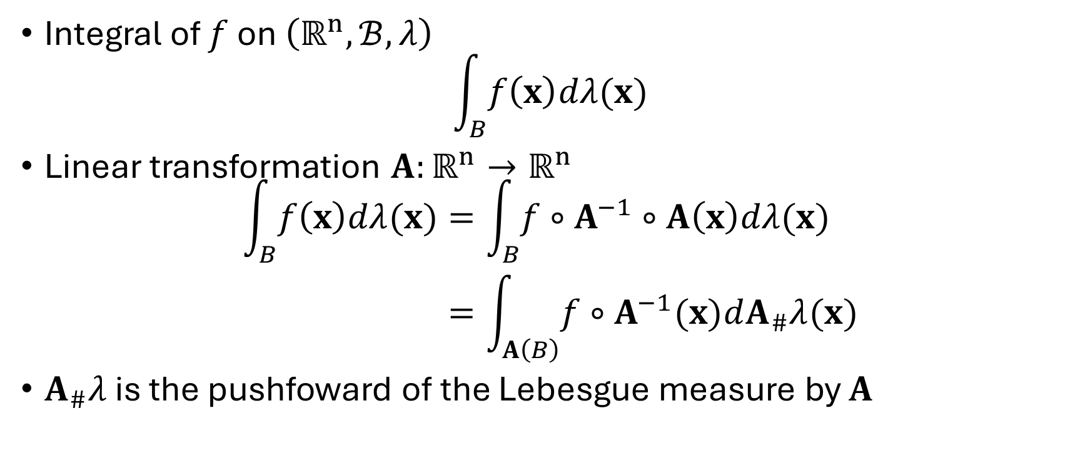
Change of variables
Integral of $f$ on $\left(ℝ^{n},ℬ,λ\right)$
$$\int_{B}{f\left(x\right)dλ(x)}$$
Linear transformation $A:ℝ^{n}→ℝ^{n}$
$$\begin{aligned}\int_{B}{f\left(x\right)dλ(x)}&=\int_{B}{f∘A^{−1}∘A\left(x\right)dλ(x)} \\ &=\int_{A\left(B\right)}{f∘A^{−1}(x)dA_{\#}λ(x)}\end{aligned}$$
$A_{\#}λ$ is the pushfoward of the Lebesgue measure by $A$

Slide 18
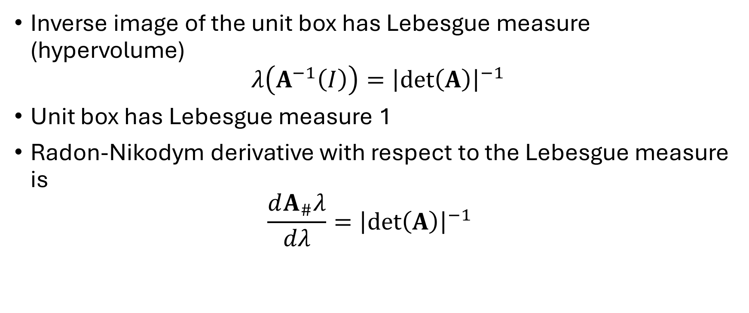
Change of variables
Inverse image of the unit box has Lebesgue measure (hypervolume)
$$λ\left(A^{−1}\left(I\right)\right)={\left|\det\left(A\right)\right|}^{−1}$$
Unit box has Lebesgue measure 1
Radon-Nikodym derivative with respect to the Lebesgue measure is $\frac{dA_{\#}λ}{dλ}={\left|\det\left(A\right)\right|}^{−1}$

Slide 19
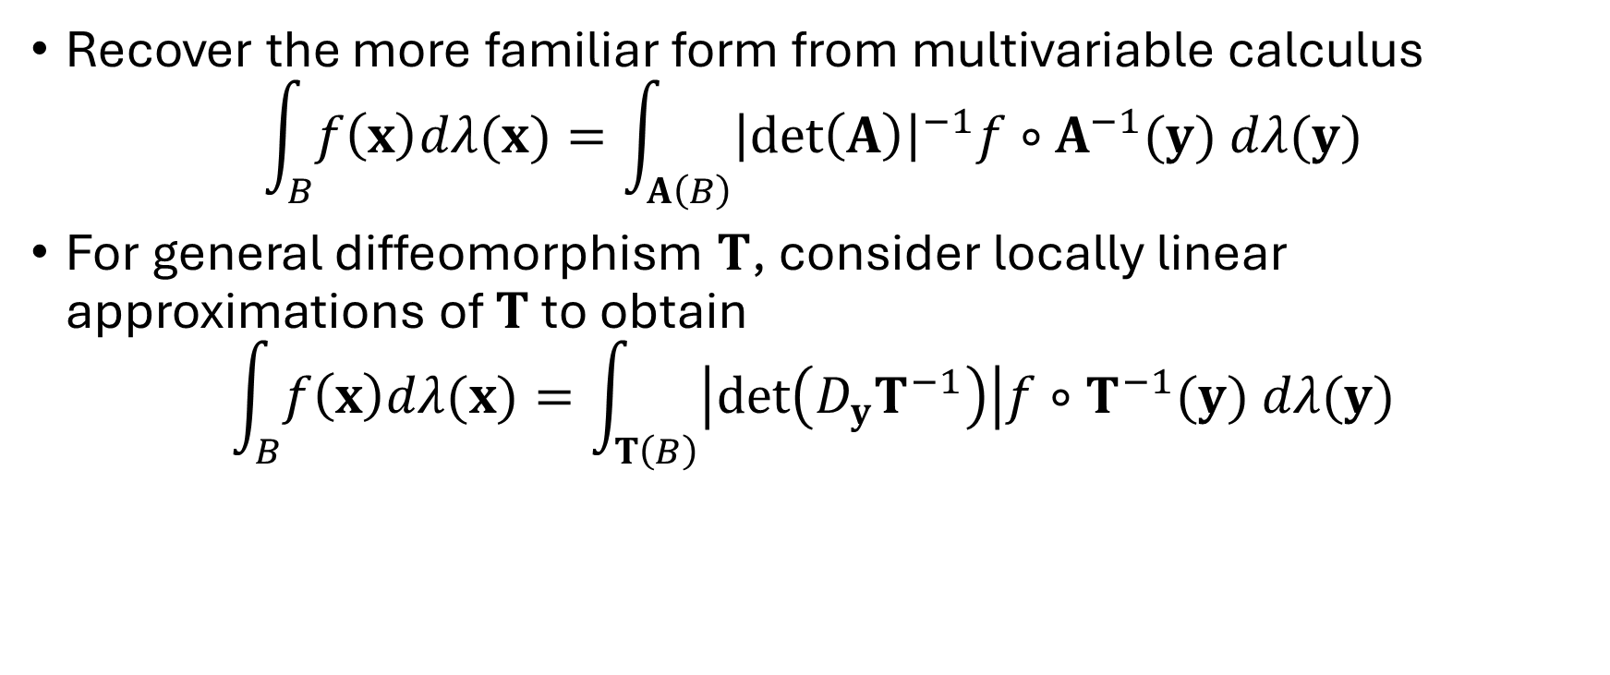
Change of variables
Recover the more familiar form from multivariable calculus
$$\int_{B}{f\left(x\right)dλ(x)}=\int_{A\left(B\right)}{{\left|\det\left(A\right)\right|}^{−1}f∘A^{−1}(y) dλ(y)}$$
For general diffeomorphism $T$, consider locally linear approximations of $T$ to obtain
$$\int_{B}{f\left(x\right)dλ(x)}=\int_{T\left(B\right)}{\left|\det\left(D_{y}T^{−1}\right)\right|f∘T^{−1}(y) dλ(y)}$$

Slide 20
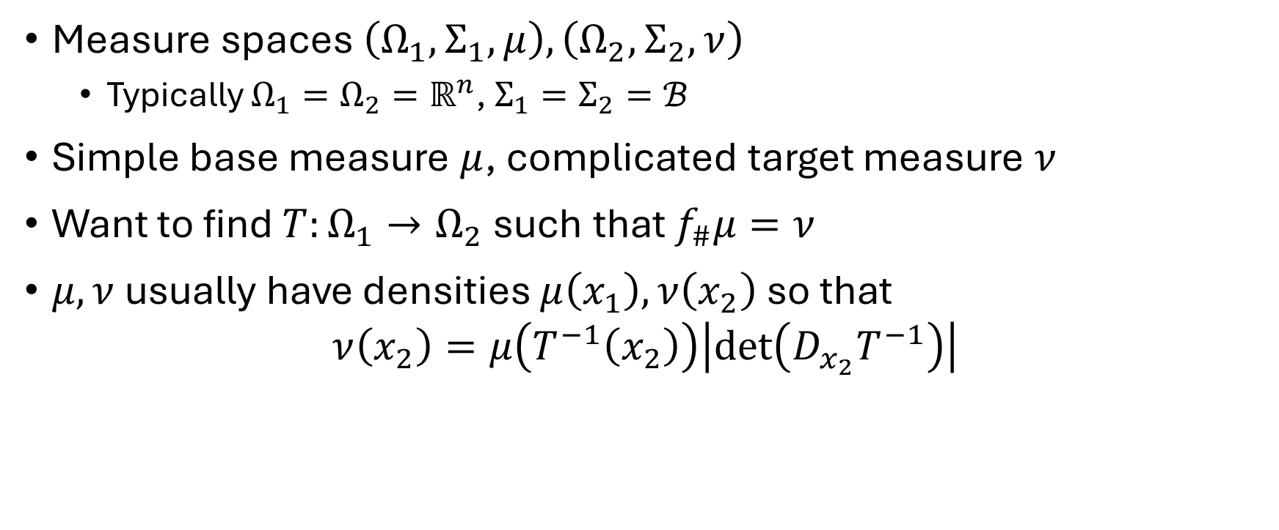
Normalizing flows
Measure spaces $\left(Ω_{1}, Σ_{1},μ\right),\left(Ω_{2},Σ_{2},ν\right)$
Typically $Ω_{1}=Ω_{2}=ℝ^{n}$, $Σ_{1}=Σ_{2}=ℬ$
Simple base measure $μ$, complicated target measure $ν$
Want to find $T:Ω_{1}→Ω_{2}$ such that $f_{\#}μ=ν$
$μ,ν$ usually have densities $μ\left(x_{1}\right),ν\left(x_{2}\right)$ so that
$$ν\left(x_{2}\right)=μ\left(T^{−1}\left(x_{2}\right)\right)\left|\det\left(D_{x_{2}}T^{−1}\right)\right|$$

Slide 21
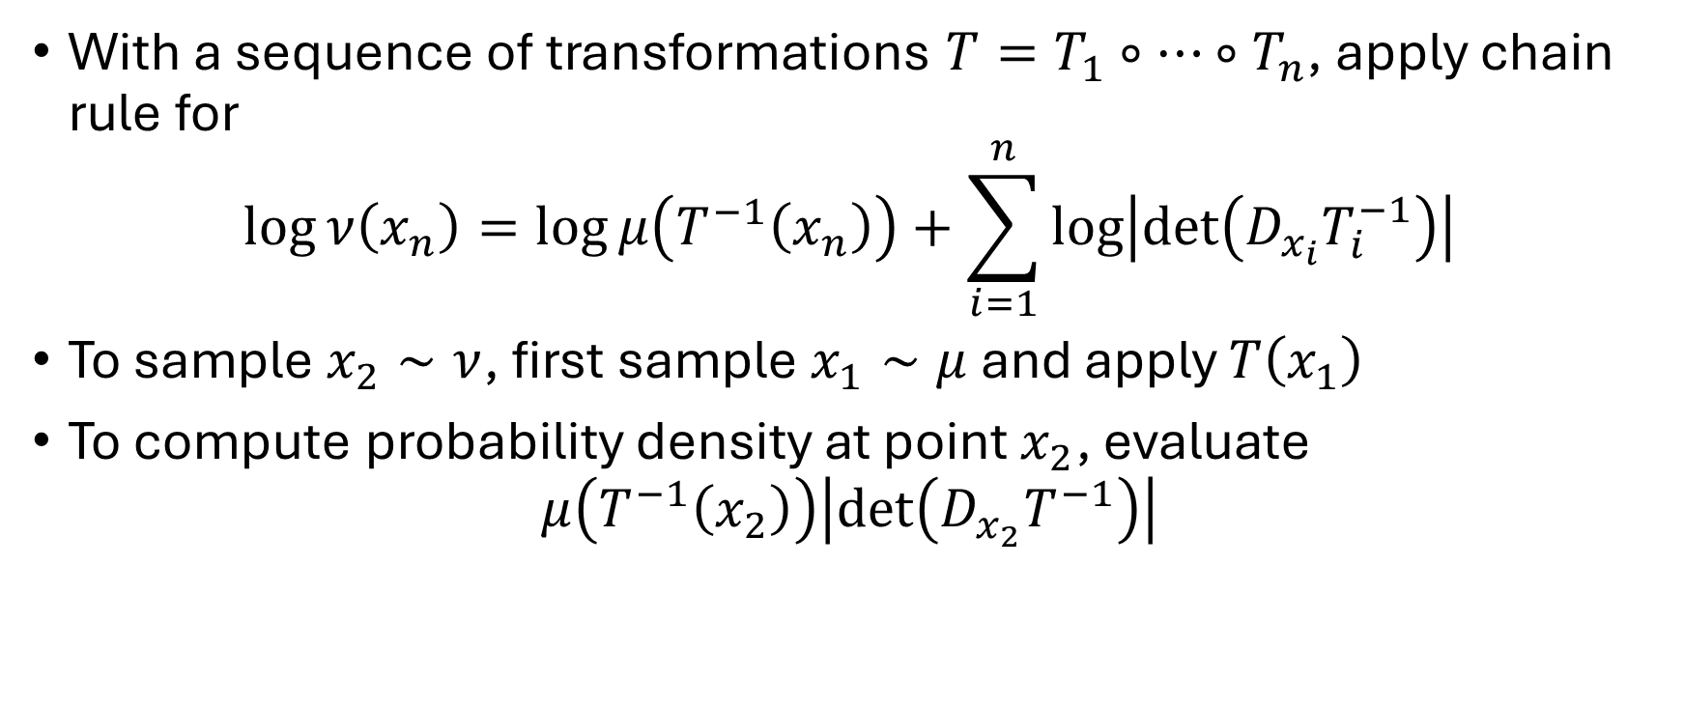
Normalizing flows
With a sequence of transformations $T=T_{1}∘…∘T_{n}$, apply chain rule for
$$\log{ν\left(x_{n}\right)=\log{μ\left(T^{−1}\left(x_{n}\right)\right)}}+\sum_{i=1}^{n}{\log\left|\det\left(D_{x_{i}}T_{i}^{−1}\right)\right|}$$
To sample $x_{2}∼ν$, first sample $x_{1}∼μ$ and apply $T\left(x_{1}\right)$
To compute probability density at point $x_{2}$, evaluate
$$μ\left(T^{−1}\left(x_{2}\right)\right)\left|\det\left(D_{x_{2}}T^{−1}\right)\right|$$

Slide 22
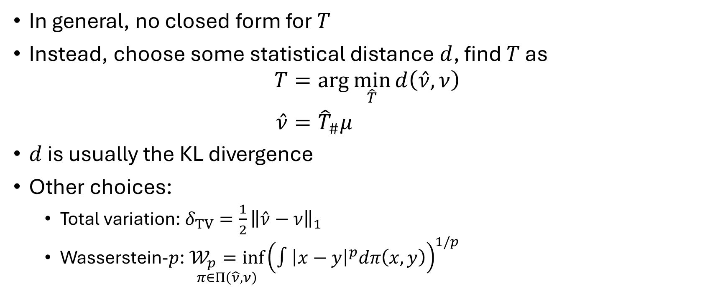
Training normalizing flows
In general, no closed form for $T$
Instead, choose some statistical distance $d$, find $T$ as
$$\begin{aligned}T&=\arg{\min_{\hat{T}}{d\left(\hat{ν},ν\right)}} \\ \hat{ν}&={\hat{T}}_{\#}μ\end{aligned}$$
$d$ is usually the KL divergence
Other choices:
Total variation: $δ_{TV}=\frac{1}{2}{\left\|\hat{ν}−ν\right\|}_{1}$
Wasserstein-$p$: $\underset{π∈Π\left(\hat{ν},ν\right)}{𝒲_{p}=inf}{{\left(∫{\left|x−y\right|}^{p}dπ\left(x,y\right)\right)}^{1/p}}$

Slide 23

Training normalizing flows
Forward KL divergence:
$$\begin{aligned}𝒟_{KL}\left(ν\right|\left|\hat{ν}\right)&=𝔼_{ν}\left(\log{ν}−log{\hat{ν}}\right) \\ &=−𝔼_{ν}\left(\log{\hat{ν}}\right)+C \\ &≈−\frac{1}{N}\sum_{n=1}^{N}{\log{μ\left(T^{−1}\left(x_{n}\right)\right)+\log\left|\det\left(D_{x_{n}}T^{−1}\right)\right|}}\end{aligned}$$

Slide 24
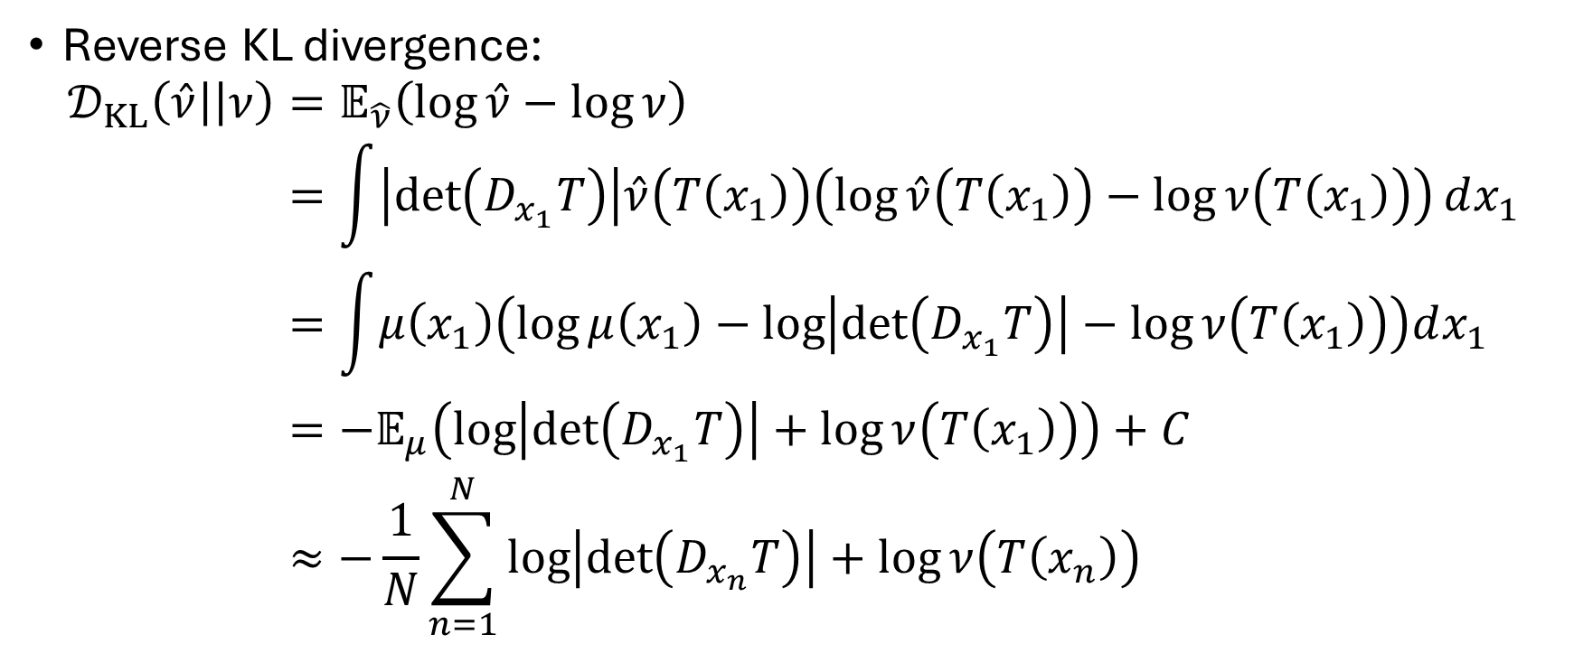
Training normalizing flows
Reverse KL divergence:
$$\begin{aligned}𝒟_{KL}\left(\hat{ν}\right|\left|ν\right)&=𝔼_{\hat{ν}}\left(\log{\hat{ν}−\log{ν}}\right) \\ &=\int{\left|\det\left(D_{x_{1}}T\right)\right|\hat{ν}\left(T\left(x_{1}\right)\right)\left(\log{\hat{ν}\left(T\left(x_{1}\right)\right)}−\log{ν\left(T\left(x_{1}\right)\right)}\right)}dx_{1} \\ &=\int{μ\left(x_{1}\right)\left(\log{μ\left(x_{1}\right)−\log\left|\det\left(D_{x_{1}}T\right)\right|}−\log{ν\left(T\left(x_{1}\right)\right)}\right)dx_{1} } \\ &=−𝔼_{μ}\left(\log\left|\det\left(D_{x_{1}}T\right)\right|+\log{ν\left(T\left(x_{1}\right)\right)}\right)+C \\ &≈−\frac{1}{N}\sum_{n=1}^{N}{\log\left|\det\left(D_{x_{n}}T\right)\right|+\log{ν\left(T\left(x_{n}\right)\right)}}\end{aligned}$$

Slide 25

Training normalizing flows
Forward KL is good when samples can be drawn from $ν$
Reverse KL is good when $ν$ can be evaluated up to a normalizing constant

Slide 26
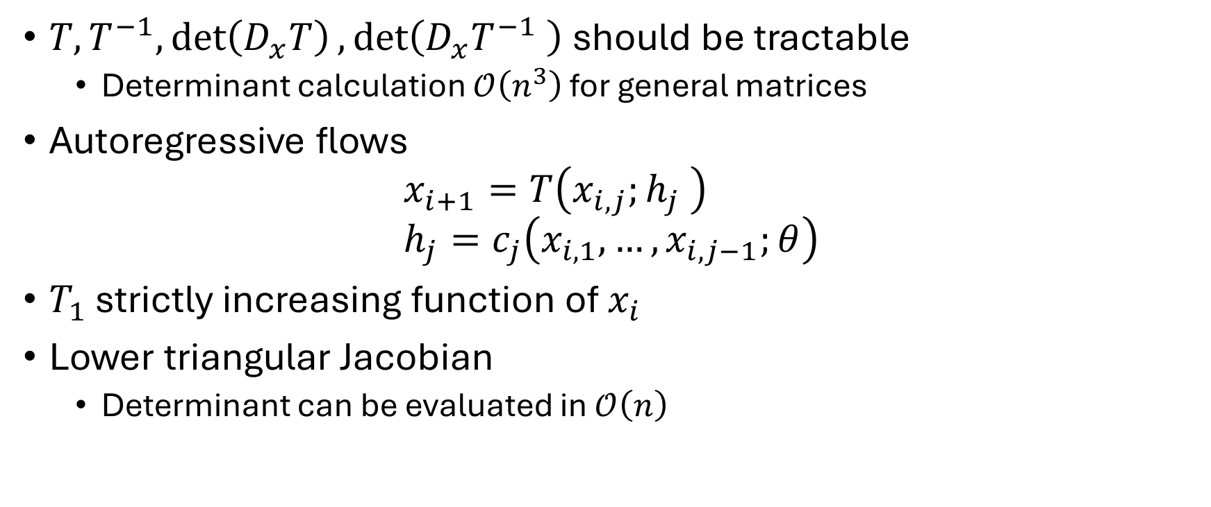
Normalizing flow architectures
$T,T^{−1},\det\left(D_{x}T\right),\det\left(D_{x}T^{−1} \right)$ should be tractable
Determinant calculation $𝒪\left(n^{3}\right)$ for general matrices
Autoregressive flows
$$x_{i+1}=T\left(x_{i,j};h_{j} \right) \\ h_{j}=c_{j}\left({x_{i,1},…,x}_{i,j−1};θ\right)$$
$T_{1}$ strictly increasing function of $x_{i}$
Lower triangular Jacobian
Determinant can be evaluated in $𝒪\left(n\right)$

Slide 27
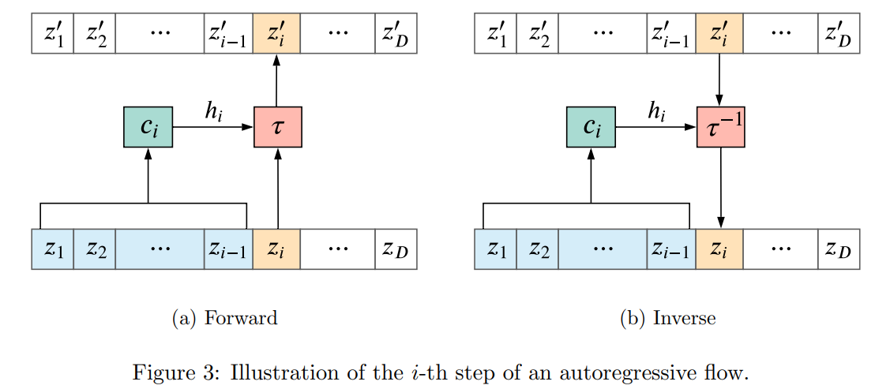
Autoregressive flows

Slide 28

Autoregressive flows
Choices of $T$
Affine: $T\left(z_{i,j};h_{j}\right)=α_{j}z_{i,j}+β_{j}, h_{j}=\left\{α_{j},β_{j}\right\}$
Conical combination: $T\left(z_{i,j};h_{j}\right)=\sum_{k=1}^{K}{w_{j,k}T_{k}\left(z_{i,j}\right), w_{jk}>0}$

Slide 29
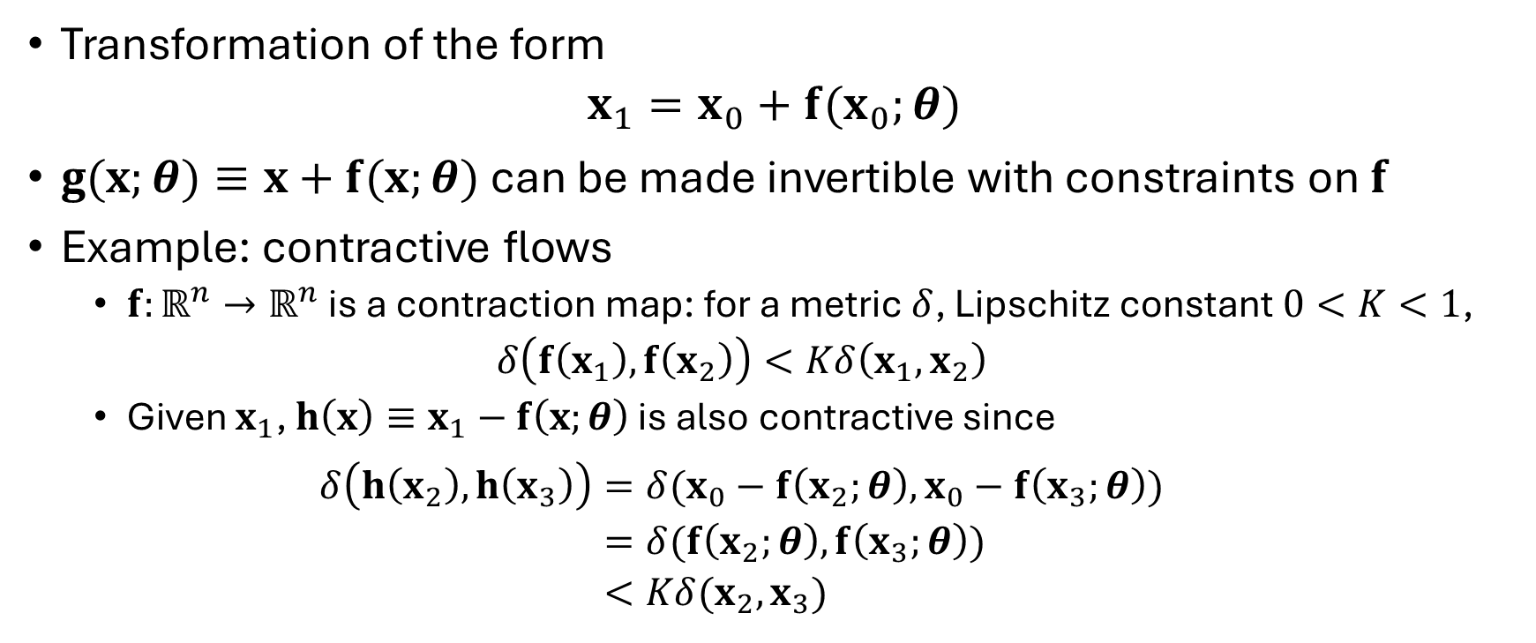
Residual flows
Transformation of the form
$$x_{1}=x_{0}+f(x_{0};θ)$$
$g(x;θ)≡x+f(x;θ)$ can be made invertible with constraints on $f$
Example: contractive flows
$f:ℝ^{n}→ℝ^{n}$ is a contraction map: for a metric $δ$, Lipschitz constant $0<K<1$,
$$δ\left(f\left(x_{1}\right),f\left(x_{2}\right)\right)<Kδ\left(x_{1},x_{2}\right)$$
Given $x_{1}$, $h\left(x\right)≡x_{1}−f\left(x;θ\right)$ is also contractive since
$$\begin{aligned}δ\left(h\left(x_{2}\right),h\left(x_{3}\right)\right)&=δ(x_{0}−f\left(x_{2};θ\right),x_{0}−f\left(x_{3};θ\right)) \\ &=δ(f\left(x_{2};θ\right), f\left(x_{3};θ\right)) \\ &<Kδ(x_{2},x_{3})\end{aligned}$$

Slide 30
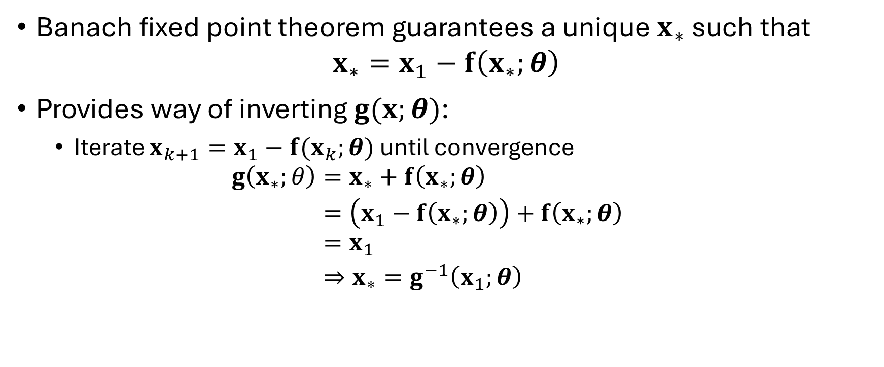
Contractive flows
Banach fixed point theorem guarantees a unique $x_{∗}$ such that
$$x_{∗}=x_{1}−f\left(x_{∗};θ\right)$$
Provides way of inverting $g(x;θ)$:
Iterate $x_{k+1}=x_{1}−f(x_{k};θ)$ until convergence
$$\begin{aligned}g\left(x_{∗};θ\right)&=x_{∗}+f\left(x_{∗};θ\right)& \\ &=\left(x_{1}−f\left(x_{∗};θ\right)\right)+f\left(x_{∗};θ\right) \\ &=x_{1} \\ &⇒x_{∗}=g^{−1}\left(x_{1};θ\right)\end{aligned}$$

Slide 31

Shortcomings
Autoregressive flows:
Tractable Jacobian restricts expressivity of maps
Residual flows:
$𝒪\left(n^{3}\right)$ Jacobian evaluation cost

Slide 32
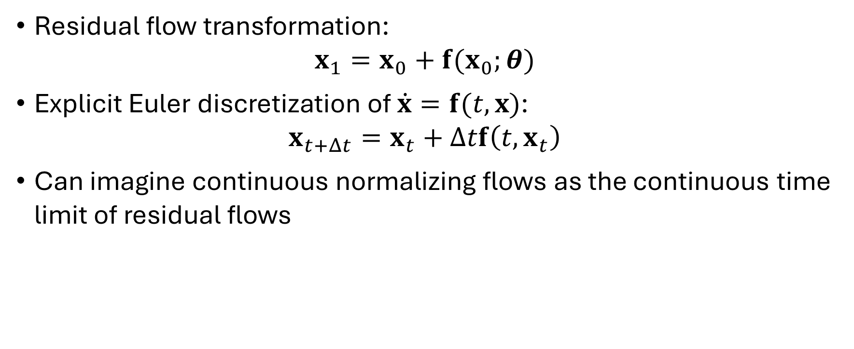
Continuous (time) normalizing flows (CNFs)
Residual flow transformation:
$$x_{1}=x_{0}+f(x_{0};θ)$$
Explicit Euler discretization of $\dot{x}=f(t,x)$:
$$x_{t+Δt}=x_{t}+Δtf\left(t,x_{t}\right)$$
Can imagine continuous normalizing flows as the continuous time limit of residual flows

Slide 33
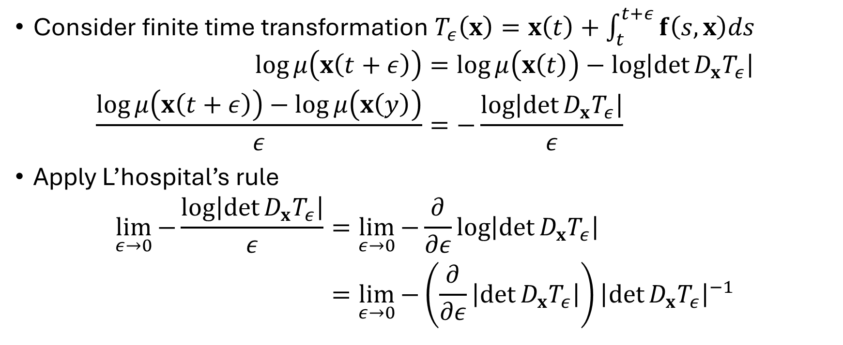
Instantaneous change of variables
Consider finite time transformation $T_{ε}\left(x\right)=x\left(t\right)+\int_{t}^{t+ε}{f\left(s,x\right)ds}$
$$\begin{aligned}\log{μ\left(x\left(t+ε\right)\right)}&=\log{μ\left(x\left(t\right)\right)−\log\left|\det{D_{x}T_{ε}}\right|} \\ \frac{\log{μ\left(x\left(t+ε\right)\right)}−\log{μ\left(x\left(y\right)\right)}}{ε}&=−\frac{\log\left|\det{D_{x}T_{ε}}\right|}{ε}\end{aligned}$$
Apply L’hospital’s rule
$$\begin{aligned}\lim_{ε→0}{−\frac{\log\left|\det{D_{x}T_{ε}}\right|}{ε}}&=\lim_{ε→0}{−\frac{∂}{∂ε}\log\left|\det{D_{x}T_{ε}}\right|} \\ &=\lim_{ε→0}{−\left(\frac{∂}{∂ε}\left|\det{D_{x}T_{ε}}\right|\right){\left|\det{D_{x}T_{ε}}\right|}^{−1}}\end{aligned}$$

Slide 34
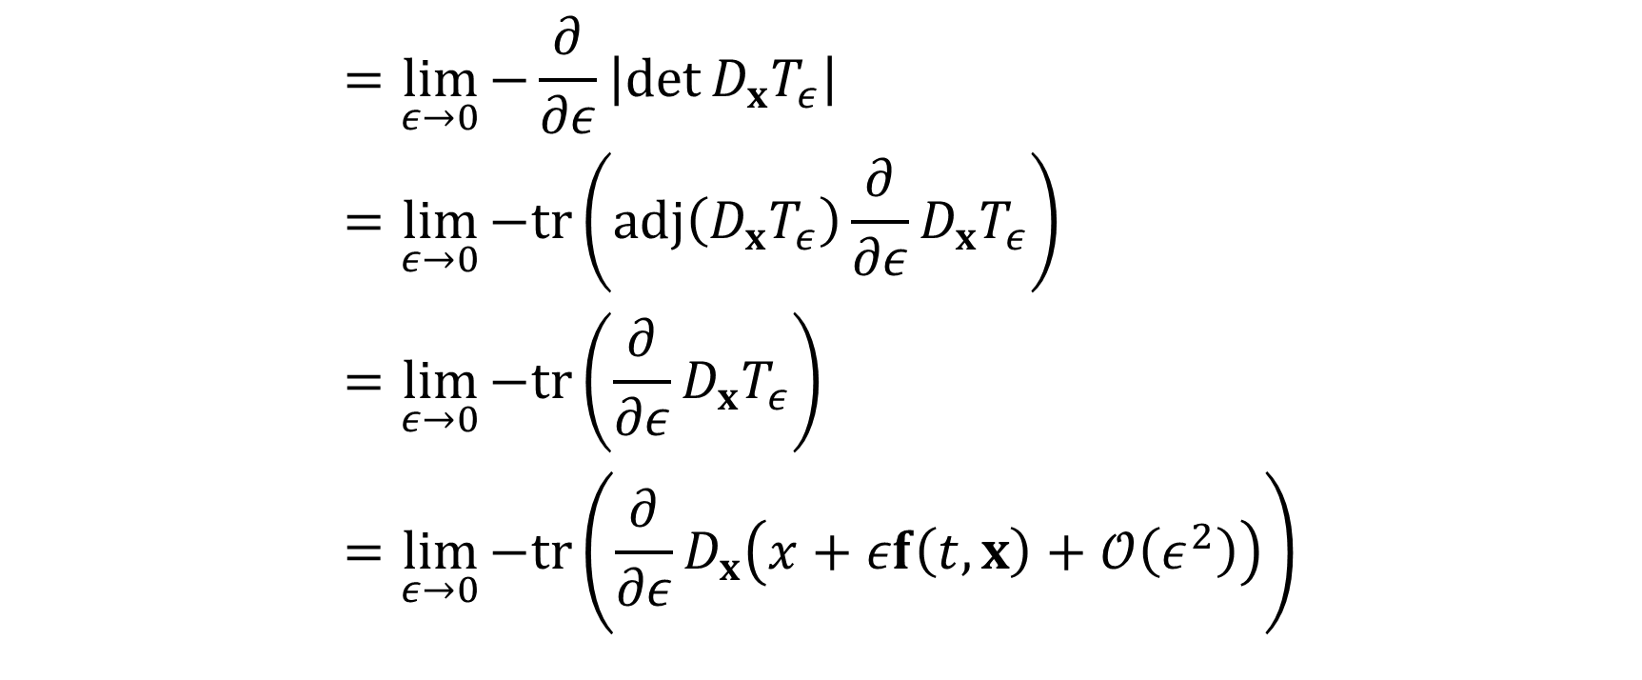
Instantaneous change of variables
$$\begin{aligned}&=\lim_{ε→0}{−\frac{∂}{∂ε}\left|\det{D_{x}T_{ε}}\right|} \\ &=\lim_{ε→0}{−tr\left(adj\left(D_{x}T_{ε}\right)\frac{∂}{∂ε}D_{x}T_{ε}\right)} \\ &=\lim_{ε→0}{−tr\left(\frac{∂}{∂ε}D_{x}T_{ε}\right)} \\ &=\lim_{ε→0}{−tr\left(\frac{∂}{∂ε}D_{x}\left(x+εf\left(t,x\right)+𝒪\left(ε^{2}\right)\right)\right)}\end{aligned}$$

Slide 35

Instantaneous change of variables
$$\begin{aligned}&=\lim_{ε→0}{−tr\left(\frac{∂}{∂ε}\left(I+εD_{x}f\left(t,x\right)+𝒪\left(ε^{2}\right)\right)\right)}& \\ &=\lim_{ε→0}{−tr\left(\left(D_{x}f\left(t,x\right)+𝒪\left(ε\right)\right)\right)} \\ &=−∇⋅f\end{aligned}$$

Slide 36
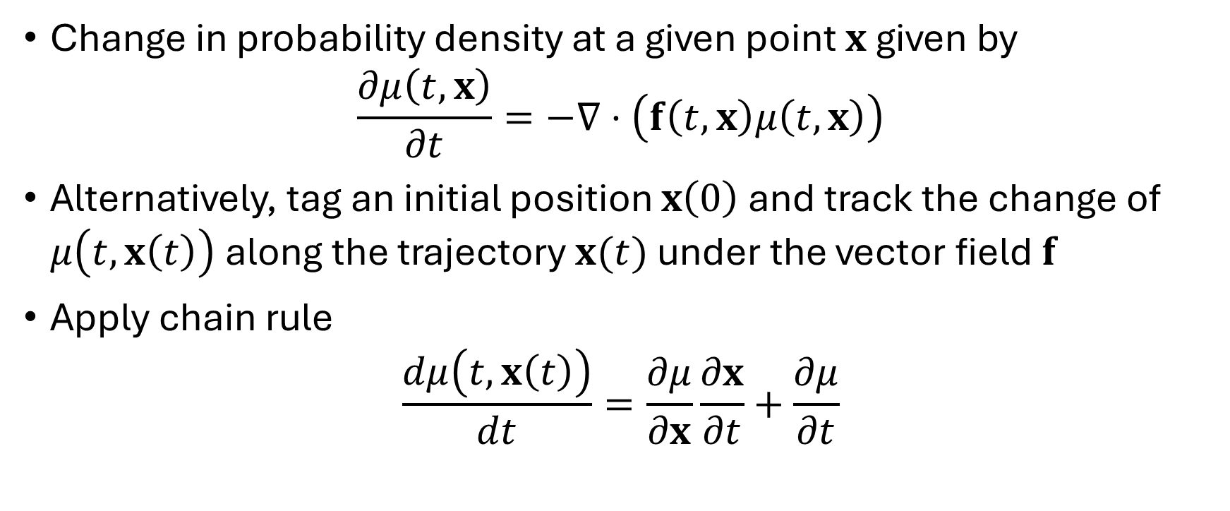
Continuity equation
Change in probability density at a given point $x$ given by
$$\frac{∂μ\left(t,x\right)}{∂t}=−∇⋅\left(f\left(t,x\right)μ\left(t,x\right)\right)$$
Alternatively, tag an initial position $x\left(0\right)$ and track the change of $μ\left(t,x\left(t\right)\right)$ along the trajectory $x(t)$ under the vector field $f$
Apply chain rule
$$\frac{dμ\left(t,x\left(t\right)\right)}{dt}=\frac{∂μ}{∂x}\frac{∂x}{∂t}+\frac{∂μ}{∂t}$$

Slide 37
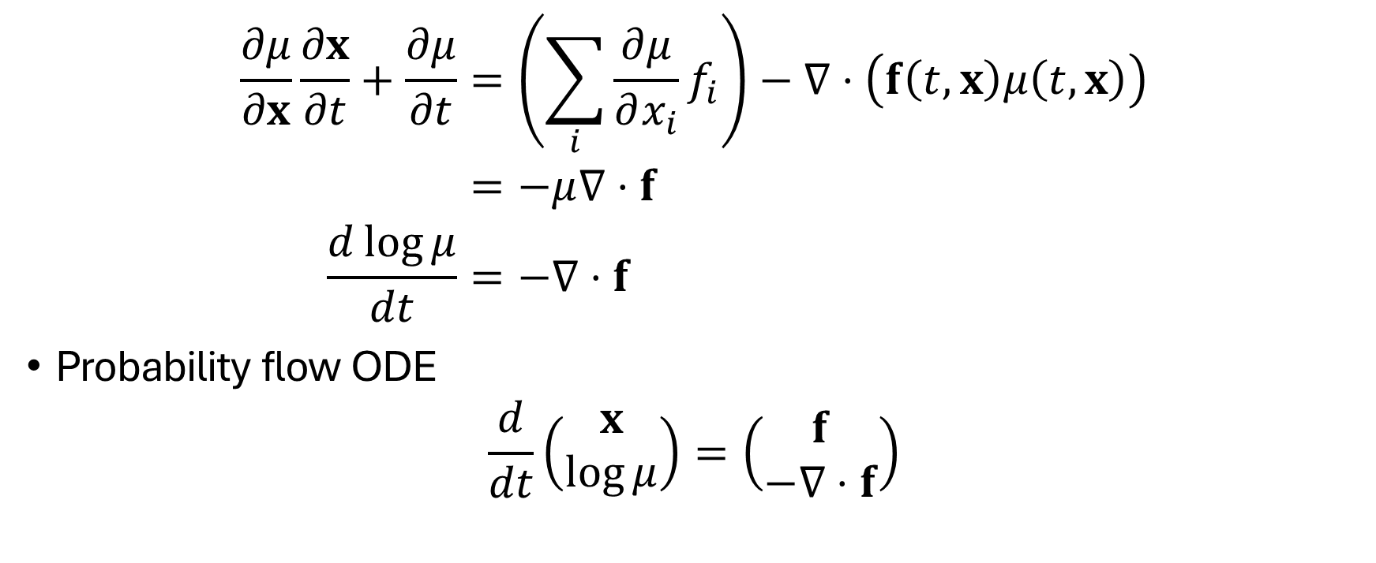
Continuity equation
$$\begin{aligned}\frac{∂μ}{∂x}\frac{∂x}{∂t}+\frac{∂μ}{∂t}&=\left(\sum_{i}{\frac{∂μ}{∂x_{i}}f_{i}}\right)−∇⋅\left(f\left(t,x\right)μ\left(t,x\right)\right) \\ &=−μ∇⋅f \\ \frac{d\log{μ}}{dt}&=−∇⋅f \end{aligned}$$
Probability flow ODE
$$\frac{d}{dt}\left(\begin{aligned}x \\ \log{μ}\end{aligned}\right)=\left(\begin{aligned}f \\ −∇⋅f\end{aligned}\right)$$

Slide 38
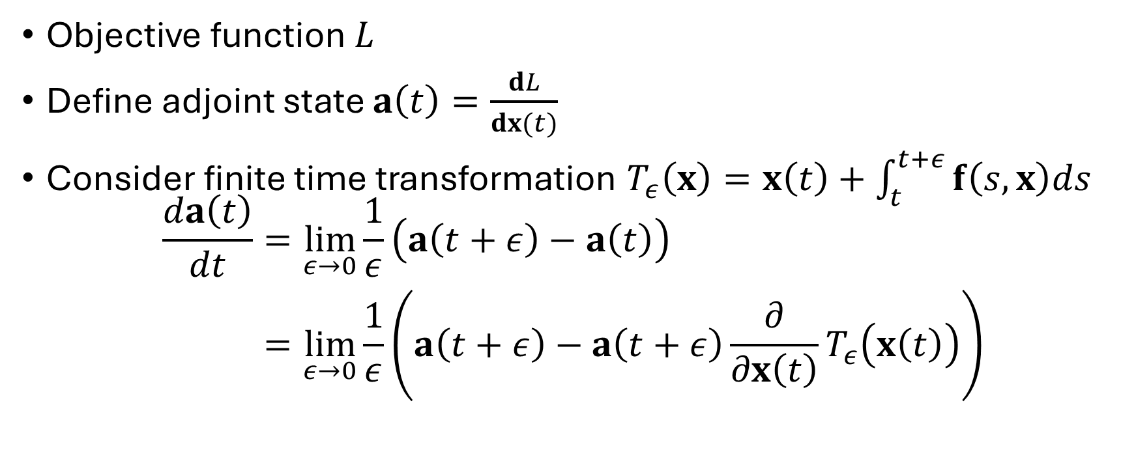
Adjoint sensitivity method
Objective function $L$
Define adjoint state $a\left(t\right)=\frac{dL}{dx(t)}$
Consider finite time transformation $T_{ε}\left(x\right)=x\left(t\right)+\int_{t}^{t+ε}{f\left(s,x\right)ds}$
$$\begin{aligned}\frac{da\left(t\right)}{dt}&=\lim_{ε→0}\frac{1}{ε}\left(a\left(t+ε\right)−a\left(t\right)\right) \\ &=\lim_{ε→0}\frac{1}{ε}\left(a\left(t+ε\right)−a\left(t+ε\right)\frac{∂}{∂x\left(t\right)}T_{ε}\left(x\left(t\right)\right)\right)\end{aligned}$$

Slide 39
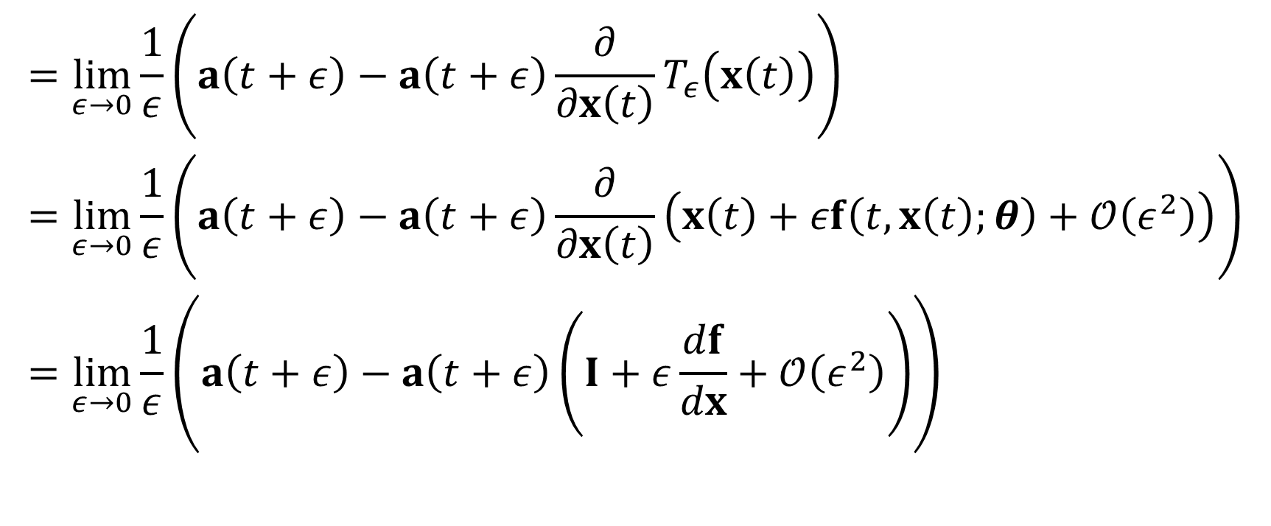
Adjoint sensitivity method
$$\begin{aligned}&=\lim_{ε→0}\frac{1}{ε}\left(a\left(t+ε\right)−a\left(t+ε\right)\frac{∂}{∂x\left(t\right)}T_{ε}\left(x\left(t\right)\right)\right) \\ &=\lim_{ε→0}\frac{1}{ε}\left(a\left(t+ε\right)−a\left(t+ε\right)\frac{∂}{∂x\left(t\right)}\left(x\left(t\right)+εf\left(t,x\left(t\right);θ\right)+𝒪\left(ε^{2}\right)\right)\right) \\ &=\lim_{ε→0}\frac{1}{ε}\left(a\left(t+ε\right)−a\left(t+ε\right)\left(I+ε\frac{df}{dx}+𝒪\left(ε^{2}\right)\right)\right) \\ \end{aligned}$$

Slide 40
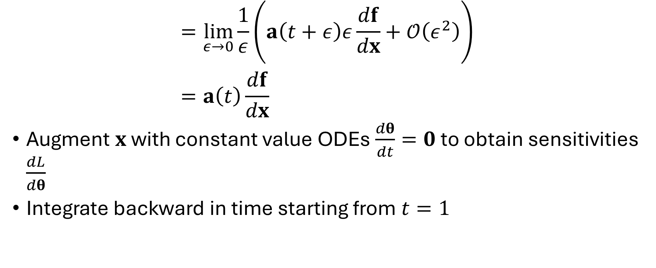
Adjoint sensitivity method
$$\begin{aligned}&=\lim_{ε→0}\frac{1}{ε}\left(a\left(t+ε\right)ε\frac{df}{dx}+𝒪\left(ε^{2}\right)\right) \\ &=a\left(t\right)\frac{df}{dx}\end{aligned}$$
Augment $x$ with constant value ODEs $\frac{dθ}{dt}=0$ to obtain sensitivities $\frac{dL}{dθ}$
Integrate backward in time starting from $t=1$

Slide 41
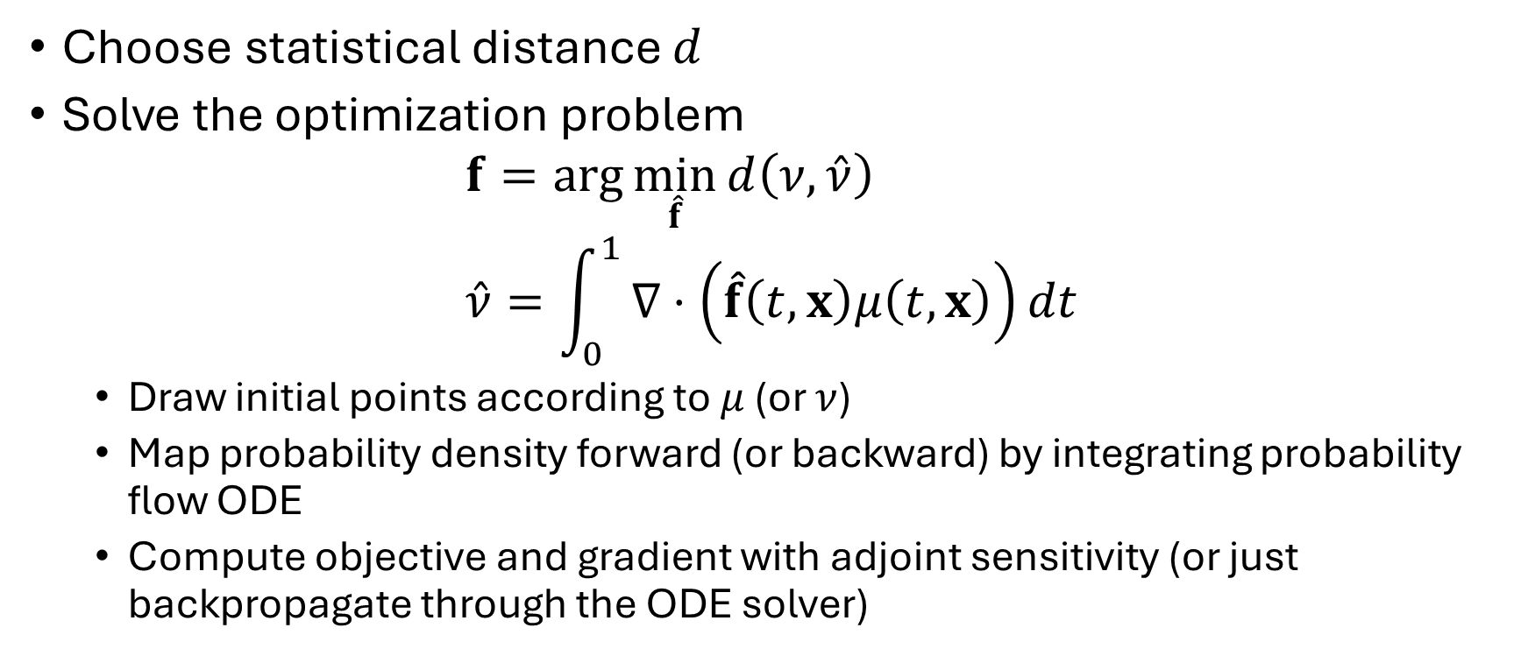
Training CNFs
Choose statistical distance $d$
Solve the optimization problem
$$f=\arg{\min_{\hat{f}}{d\left(ν, \hat{ν}\right)}} \\ \hat{ν}=\int_{0}^{1}{∇⋅\left(\hat{f}\left(t,x\right)μ\left(t, x\right)\right)dt}$$
Draw initial points according to $μ$ (or $ν$)
Map probability density forward (or backward) by integrating probability flow ODE
Compute objective and gradient with adjoint sensitivity (or just backpropagate through the ODE solver)

Slide 42

Training continuous normalizing flows
Hutchinson trace estimator:
$$∇⋅f≈v^{T}\left(D_{x}f\right)v$$
$v$ is a random vector with mean 0, identity covariance

Slide 43
Advantages and disadvantages of CNFs
Advantages:
Automatically invertible: can integrate forward and backward in time
Don’t have to worry about tractability of the Jacobian
Can use more general neural network architectures
Possibly more expressive
Disadvantages:
Have to integrate an ODE when evaluating objective + gradients (simulation based method)
Stiffness
Expensive
Bifurcations of the ODE

Slide 44
References
Real Analysis, Folland
Normalizing Flows for Probabilistic Modeling and Inference
Neural Ordinary Differential Equations
Building Normalizing Flows with Stochastic Interpolants

